Slide 1
Next Steps Information Evening, 8th June 2022
UCAS – The application process
Matthew Mobberley, Head of Sixth Form

Slide 2
Plan for the evening:
UCAS – The application process – 6:30-7:00
Apprenticeships – 7:15-7:45
Oxbridge, Medicine, Veterinary Science, Dentistry and Law – 8:00-8:30

Slide 3
Your questions
What is UCAS?
How do you show evidence of super-curricular activity?
What are the dates/ deadlines for applying?
How do you write the personal statement?
What should I consider when choosing a course?
What should I consider when choosing an institution?
How many universities can you apply to?
How many offers can you accept?
What happens if you don’t get the grades?
How does the points system work? Is it different for different universities?
What about student finance?

Slide 4

UCAS – an independent charity
UCAS does:
process applications
provide information, advice, and training
have a Fraud and Verification Team
take part in education sector engagement
UCAS doesn’t:
suggest courses or universities
make decisions or offers
advise on finance, immigration, or visas for individuals
Security marking: PUBLIC
06 June 2022
| 4
Notes:
4

Slide 5
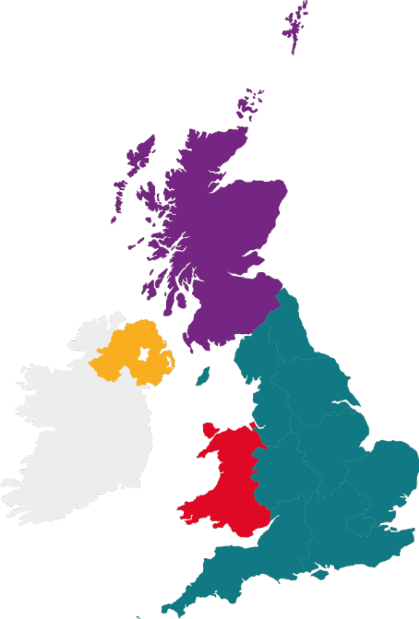
What is UCAS?
350+ universities and colleges:
  4 in Northern Ireland
  15 in Wales
  18 in Scotland
  316 in England
35,000+ courses available
Security marking: PUBLIC
06 June 2022
| 5

Slide 6
Choices available
Higher education
Apprenticeships/ traineeships
Studying abroad
Gap year
Getting a job
Find out more: ucas.com
Security marking: PUBLIC
06 June 2022
| 6

Slide 7
Apprenticeship advice
Head to: ucas.com/apprenticeships
UCAS has apprenticeship advice to help students make informed decisions about their post-16 and post-18 opportunities.
Find out about:
  the different types of apprenticeships
  how to find and apply for apprenticeships
  preparing for the application and interview process
More information will be covered in Mrs Watmore’s presentation at 7:15.
Security marking: PUBLIC
06 June 2022
| 7

Slide 8
Why higher education?
Opportunities while studying:
Chance to study a subject they are passionate about.
Achieve a qualification that could lead to their chosen career.
Grow in confidence, make lifelong friends, and gain independence and important life skills that will widen their prospects.
With a degree, they’ll have:
  the opportunity to follow their career path
  better job prospects, as many employers target graduates
  higher earning potential
Security marking: PUBLIC
06 June 2022
| 8

Slide 9
Choosing the right university
Style – from the traditional, with a focus on subject-based courses and research, to modern universities, with a greater focus on vocational courses.
Location – some are based in large cities, others in smaller towns - a major influence on the environment and lifestyle.
Size – larger universities can have more than 20,000 students, whereas some of the smallest have only a few thousand.
Culture and facilities – influenced by a range of factors, including the diversity of students who attend.
What graduates do – all universities collect destination statistics. It can be interesting to find out the types of jobs or further study students go on to.
Tuition fees – can vary between course providers. Check if there are any scholarships or bursaries available.
Living costs – accommodation, transport, and food can vary enormously.
Security marking: PUBLIC
06 June 2022
| 9

Slide 10
Choosing the right course
What does the course cover?
Courses with the same title may be very different.
Look carefully at the core course content, and the range of optional studies/modules available.
Which modules are the most interesting and relevant to career aspirations?
See if the course or university/college offers any internship, placement, or study abroad opportunities.
How is the course taught – structured teaching, or more independent research? How many lectures are there, and how much group work will be done in seminars?
How is the course assessed?
Security marking: PUBLIC
06 June 2022
| 10

Slide 11
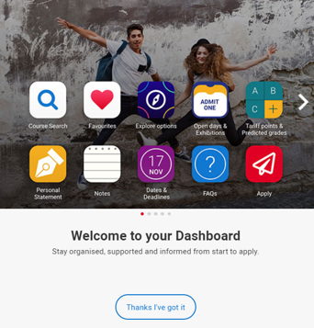
Starting research
Students should register in UCAS Hub to:
explore careers, subjects, universities and apprenticeships
find and favourite over 35,000 courses
search for virtual tours and online events
turn predicted grades into Tariff points
speak to those in the know using Unibuddy
speak to career, higher education, and application specialists by attending the Hub lives.
explore job profiles to discover different career roles and pathways.
Start an application for 2022 entry (from May 2021)
Security marking: PUBLIC
06 June 2022
| 11

Slide 12
Organise everything in one place…
Get organised:
Tools to search, favourite, shortlist, reflect, diary, and build application.
Define what’s important:
Distance from home, teaching satisfaction, work experience options, job outcomes…
Make it yours:
Organise tools, remove the ones they don’t need, and tick off their to do list. It’s their space, and their future.
Expanding horizons…
…by pushing options they might not have considered.
Security marking: PUBLIC
06 June 2022
| 12

Slide 13
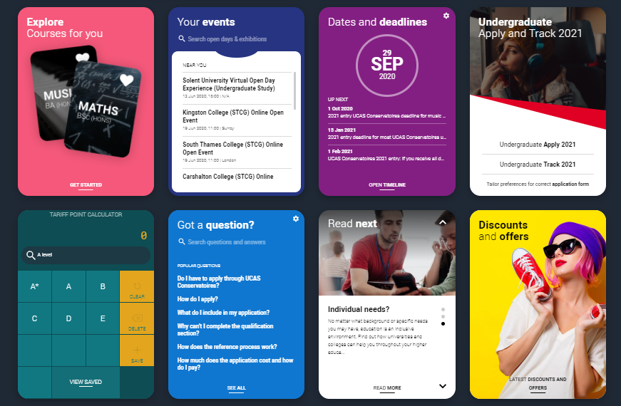


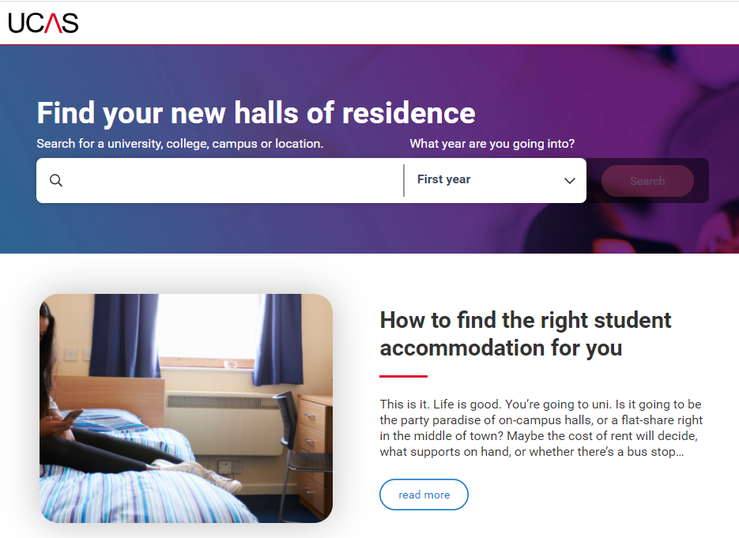

Free tools to help…
Discovery Days - at UCAS/Discovery you can explore all kinds of possibilities. Talk to subject and admissions experts, discover apprenticeships, get advice on personal statements, applying through UCAS, and more. Get stuck in and open your mind to a world of opportunities.
Join our UCAS Hub lives and Facebook lives -each live session is hosted by an expert panel to give you what you need to make an informed decision.
Accommodation Search- accommodation is high on the list when considering where you want to study, but it’s not always easy to compare what’s on offer. Understand what options there are using our new Accomodation search.

Slide 14
When to apply for 2022 entry
18 May
UCAS Undergraduate Apply opens for 2022 entry.
7 September
First day UCAS can receive a completed application to process
15 October
UCAS Application deadline for courses in medicine, veterinary medicine/science, and dentistry, and courses at Oxford or Cambridge.
26 January
UCAS Equal consideration application deadline.
February
UCAS Extra opens.
End of June
Last date for applications before Clearing opens.
Security marking: PUBLIC
06 June 2022
| 14

Slide 15
Applying - key facts
Register with UCAS via the Hub
Use your username and password to apply online
Students can add up to 5 choices, unless they’re applying to study medicine, veterinary, medicine/science, dentistry – then it’s 4 choices
Students can’t apply to BOTH Oxford and Cambridge
Applying costs £22 for 1 choice, or £26.50 for 5 choices
Apply by the equal consideration date
Providers can’t see other choices when you apply

Slide 16
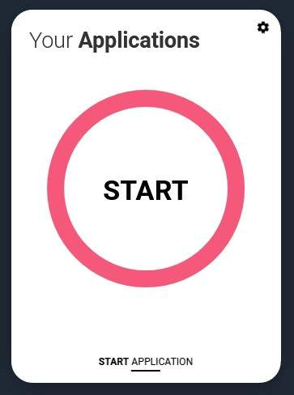
Registering
To start an application students need a UCAS Hub account.
Register for a UCAS Hub account at any time
From 18 May you’ll see a new ‘Your applications’ tile in your UCAS Hub
Click ‘Start application’ to get started…

Slide 17
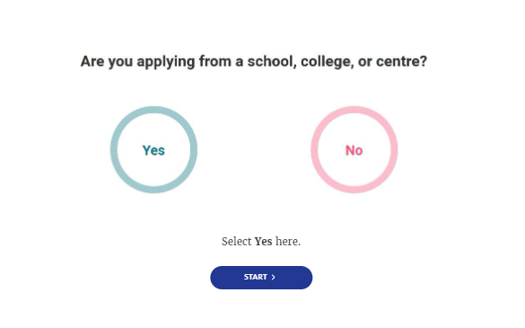
Linking to a school
If they’re applying with the help of a school, college or centre they should enter their ‘buzzword’ to link their application.
The buzzword is a unique code for our centre – CWLC2023
By linking their application students are giving us permission to view and track their application.
It also means we can provide a reference.

Slide 18
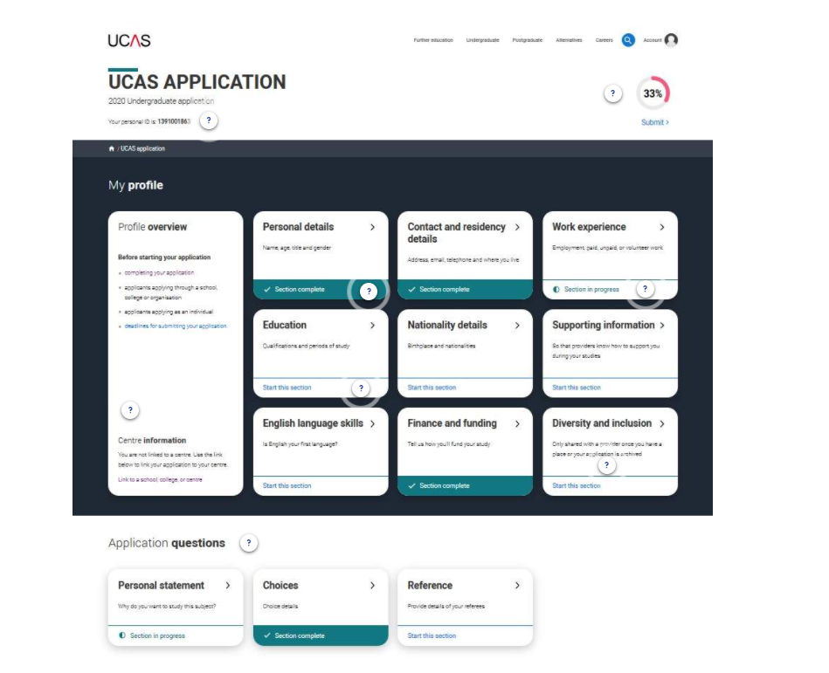
Making an application
Sections to be completed:
Personal details
Contact and residency details
Work experience
Education
Nationality details
English language skills
Supporting information
Personal statement
Choices – make up to five
References
Finance and funding
Diversity and inclusion (for students with a UK home address)
Security marking: PUBLIC
06 June 2022
| 18

Slide 19
Grades or points?
Many universities give offers based on grades e.g. AAB
Many also give offers based on points e.g. 136 points (more in a minute)
Variations:
AAB (including an A in ‘subject’)
AAB or ABB with an EPQ
AAB or BBB through a widening participation scheme (GOOGLE ‘University widening participation’) – e.g. Access to Birmingham (A2B) https://www.birmingham.ac.uk/teachers/year-12/pathways-to-birmingham/a2b/index.aspx

Slide 20
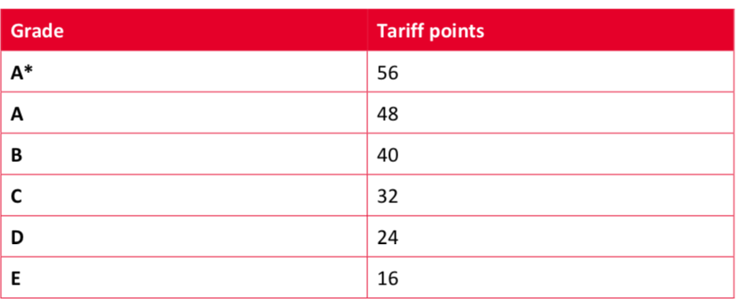
The UCAS Tariff – A Levels

Slide 21
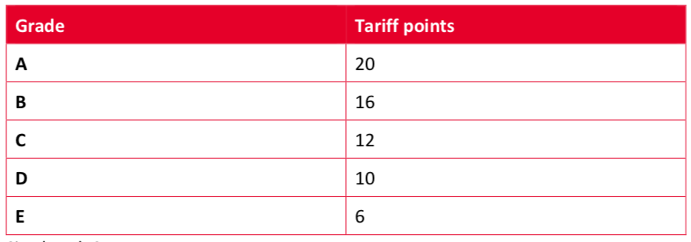
The UCAS Tariff – AS Levels

Slide 22
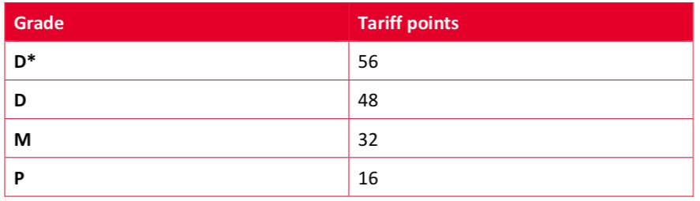
UCAS Tariff – BTEC (Single)

Slide 23







The personal statement
The only section students have full control over
Students only chance to market themselves individually
The same for all choices
UCAS’ similarity detection service:
every personal statement is run through software to check for plagiarism.
A maximum of 4,000 characters, or 47 lines
A minimum of 1,000 characters
There isn’t a spelling or grammar check
No formatting is allowed
Security marking: PUBLIC
06 June 2022
| 23

Slide 24

Personal Statement: Do
Show your strengths and enthusiasm
1
Give examples and reflect on what you have learned from super-curricular activities – don’t just list
(Personal Development Blog)
2
Produce several drafts, and save each one
3
Ask for feedback, from family, friends and staff
4
Notes:
Section 7

Slide 25
Personal Statement: Don’t
Exaggerate or plagiarise
Use clichés
Make careless mistakes
Leave it until the last minute
Notes:
Section 7

Slide 26
Completing the UCAS application
Students register for a UCAS Hub account
Student complete their application – working their way through all sections and send it to their school / college
Teachers/advisers review the application and add reference and predicted grades
Applications are sent to UCAS by the school on behalf of the student
Universities/ colleges make their decisions
Security marking: PUBLIC
06 June 2022
| 26

Slide 27
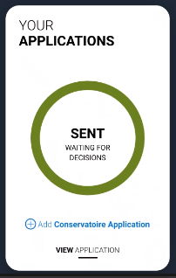
Tracking applications
Students should head to ucas.com to track their application. Click your application to:
follow the progress of their application 24/7
see their choices and personal information
view their offers
reply to offers online
In Track, a student can hold up to two offers:
  firm – if they meet the conditions of the offer they will be placed here
  insurance –if they are not placed with their firm choice, they may be placed with their insurance choice.
Security marking: PUBLIC
06 June 2022
| 27

Slide 28



Decisions
Universities and colleges will review the:
They may also ask for:
personal statement
admissions test
qualifications
interview
reference
portfolio/audition
Security marking: PUBLIC
06 June 2022
| 28

Slide 29

Replies to offers
Once students have decisions from all their choices, they can hold a maximum of two offers:
  one as a ‘firm’ acceptance – their first choice
  the other as an ‘insurance’ acceptance. This acts as a back-up if they don’t get into their ‘firm’ choice
They must then decline any remaining offers.
Once all decisions and replies have been made, if students aren’t holding an offer, they may be able to use Extra or Clearing to find available places.
Security marking: PUBLIC
06 June 2022
| 29

Slide 30

Other options
Extra (Feb – Jul)
  Used all five choices and had no offers.
  Add Extra choices for consideration one at a time in Track.
Clearing (Jul – Oct)
Apply after 30 June, receive no offers, decline all offers, not met conditions.
Find vacancies from early July, and add a Clearing choice to their application.
Security marking: PUBLIC
06 June 2022
| 30

Slide 31

What should students be doing now?
research
extracurricular activities
work experience
go beyond the syllabus
focus on this year’s studies
Security marking: PUBLIC
06 June 2022
| 31

Slide 32
How can you support them?
Research
Use the parents/guardians’ section of the UCAS website at www.ucas.com/parents.
Sign up
Sign up for parent updates from UCAS and get everything you need to know about the application process direct to your inbox.
Open days
Attend virtual events and open days – you may have a different perspective.
Be proactive
Make sure they read everything carefully that is sent to them and don’t book holidays at key times!
Security marking: PUBLIC
06 June 2022
| 32

Slide 33
Student finance – Martin Lewis
https://www.moneysavingexpert.com/students/student-loans-tuition-fees-changes/

Slide 34
Thank you
Security marking: PUBLIC
06 June 2022
| 34

