Slide 1
Oxford, Cambridge and other courses which require early applications.
Summer term 2022
Jacqui Cuerden

Slide 2
How is the application process different?
The deadline is earlier – 15th October 2022
Admissions tests and interviews
Approach to writing the personal statement
SAQ – Cambridge
Work samples
Notes:
SAQ – Supplementary Application Questionnaire – you will receive an email asking you to complete this shortly after submitting your UCAS application. Deadline for SAQ is 22 October. It’s an opportunity to tell more about the courses you have studied etc.

Slide 3
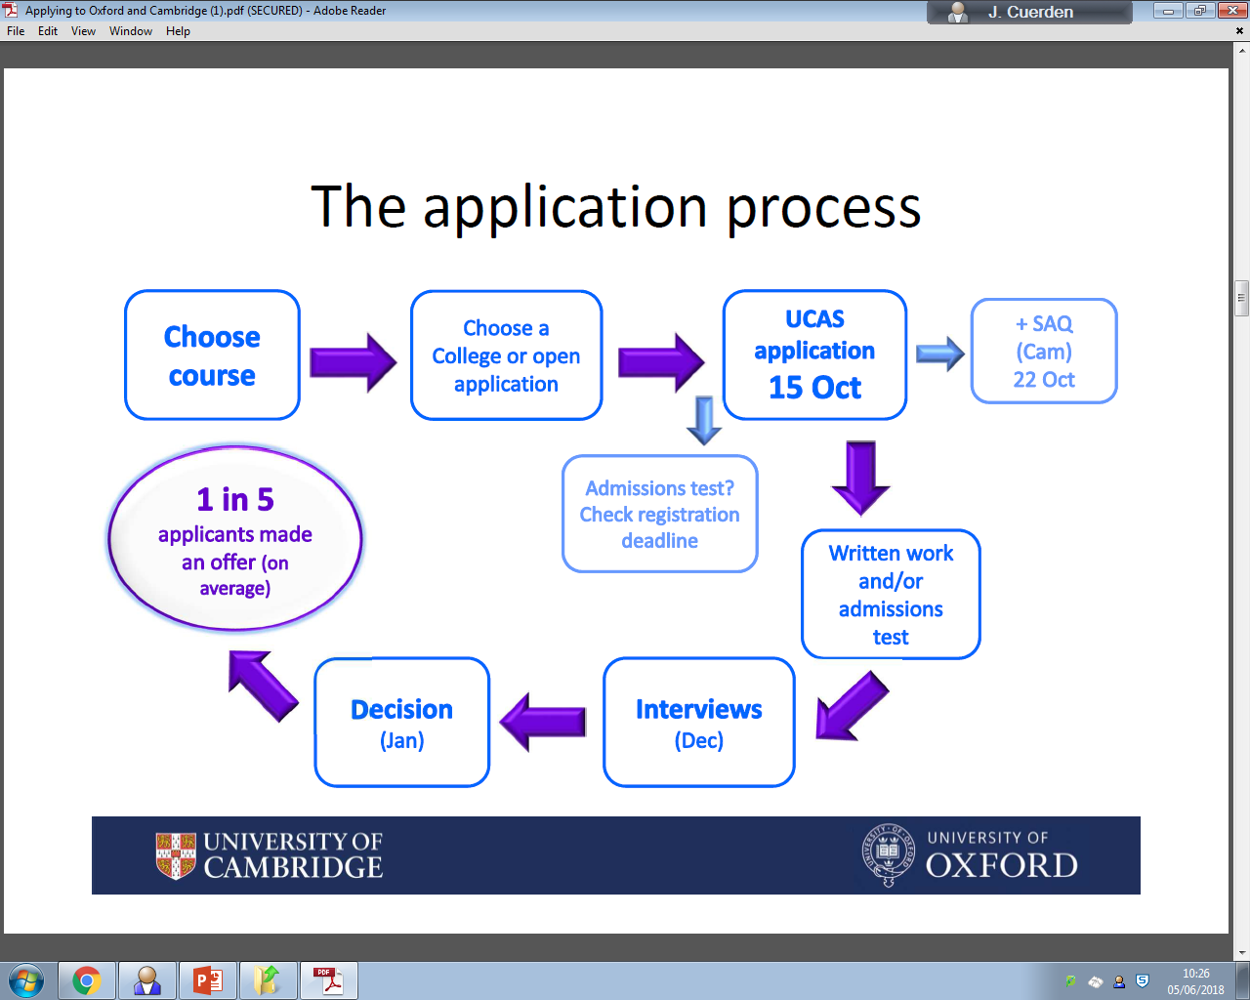
Notes:
SAQ - Shortly after submitting your UCAS application, you'll be asked via email to complete an online Supplementary Application Questionnaire (SAQ). In order to make a valid application to the University of Cambridge, you must submit your SAQ by the deadline set. In the majority of cases this deadline will be 18.00 (UK time) on 22 October. The purpose of the SAQ is to ensure that we have complete and consistent information about all applicants. It also enables us to collect information that's not part of the UCAS application but is helpful when assessing applications, such as the topics you've covered as part of your AS/A Level (or equivalent) courses (which helps our interviewers decide which questions to ask).

Slide 4

Structuring the Personal Statement
I want to study…
I have read/watched/visited…
Work experience (vocational students)
It was interesting because…
What I learned from this was….
What was challenging was…
85%
Academic
15% Extra- Curricular
In my spare time I play…
I had some work experience* at…
I enjoy…
Notes:
They want to see enthusiasm and interest for the subject WITH EVIDENCE!!
No real consideration of extra curricular…EXCEPT for vocational subjects…where reflective comments on work experience is vital!
Also, other universities will look at it – they may well be interested in the whole person.

Slide 5
What should students be doing to prepare?
For STEM subjects work on practical skills; develop understanding of techniques they are using
Attend on-line lectures; Impetus lectures; UniTaster Days; FutureLearn courses; watch podcasts; TED lectures; listen to radio programmes. Read!
Aim to show that they have a genuine interest and enthusiasm for the subject…beyond A level lessons, homework and assignments.
Make good use of The Hive
Work experience – lots of advice re: how to get around the lack of practical work experience for vocational courses
Make the most of Outreach Opportunities on offer at top universities eg subject taster days, Oxplore, UNIQ, Staircase12, Springboard, My HE+
Notes:
The Hive – University library
Students can access the BMJ, Jstore (humanity based resource.)

Slide 6
Wider reading
Additional reading – crucial
Reading journal – Personal Development Blog
Reading should be critical and analytical
What is the argument in the book/article?
What is the supporting evidence? Flaws?
What does the applicant think?
Links to other reading? EPQ?
Or explanations of how applicant has developed knowledge/skills in relation to something in the course?
Notes:
Better to read a few texts and evaluate rather than a lot and not be able to say anything about them.
Don’t say you have read something if you haven’t!!

Slide 7
Examples of Admissions Tests
Law
• Cambridge Law Test, LNAT
• Mathematics
• MAT, STEP
• Medical courses
• BMAT, University Clinical Aptitude Test (UCAT )
• Thinking Skills Assessment
• TSA Cambridge, TSA Oxford, TSA UCL
• University of Cambridge
• BMAT, MML, STEP, TSA Cambridge, Cambridge Law Test
• University of Oxford
• BMAT, CAT, ELAT, HAT, LNAT, MAT, MLAT, OLAT, PAT, PHIL, TSA Oxford
CHECK THE COURSE DETAILS ON THE WEBSITE!
Notes:
Sixth Term Examination Paper (STEP)
STEP Mathematics is a series of examination papers used to assess aptitude for university study in Mathematics and mathematical subjects.
STEP is based on material that's common to the core syllabus of A Level Mathematics (or equivalent) and so requires no further knowledge. The questions are designed to test qualities like insight, originality, and the ability to use standard techniques in unusual ways and situations. Colleges can also read applicants' examination scripts and so assess particular strengths or weaknesses which may not be conveyed in the overall mark.
STEP is used as part of almost all conditional offers in Mathematics (including Mathematics with Physics) and Computer Science with Mathematics. Some Colleges may use STEP for other courses:
Oxford – OLAT – Oriental Languages Admissions Tests

Slide 8
Admissions Tests for Medicine and Dentistry –
BMAT used by 7x HEIs , UCAT used by 26x HEIs
The BMAT more academic and theoretical questions; the UCAT is more problem-based.
The BMAT comprises multiple choice questions, short answer questions and a choice of essay questions.
The UCAT involves reasoning, decision analysis and situational judgement. It’s on-line and multiple choice. Candidates receive the results immediately after they sit the test.
HEIs use the UCAT scores in slightly different ways. Applicants need to apply strategically.
BMAT - November test date
UCAT – range of dates (July – Oct) – taken at a local test centre.
Book UCAT early to get the date you want!
Notes:
UCAT – 24th May June students can create an account and apply for access arrangements if necessary
11th July – testing starts (Last test date is 29th Sept 2022)
Go to UCAT website
For BMAT go to the Cambridge Assessment and Admissions Testing website. In 2022 there will be NO September test. Can do BMAT here. We are a registered test centre. You will need to speak to Mrs Bourne!

Slide 9
How can applicants prepare?
UCAT and BMAT – books – The Medic Portal
HE+ group with MM
Oxplore, Staircase 12, Springboard, UNIQ and HE+ websites
Practise critical thinking skills. Keep speaking to your subject tutors!
Past papers on-line; do plenty of tests – save one for near to test date! Use the university websites for past papers!
Cognito Resources website – for Medicine, Maths, Natural Sciences
Time management is crucial for ALL admissions tests
Reading questions carefully and following instructions
Notes:
No negative marking for multiple choice Qs so worth having a go.
It will be difficult; keep positive – not expected to get full marks!!

Slide 10
What to do now?
University engagement- Summer schools, Masterclasses, Subject taster days, essay competitions, Future Learn courses
Wider reading
Work experience – look for online experiences if necessary
Medics – Book UCAT test and/or register for BMAT
Start practising skills for admissions tests
Keep Personal Development Blog up to date
Work on drafting Personal Statement over the summer

Slide 11
Widening Access- Oxford
Around one in four UK students receives an Oxford Bursary or a Crankstart Scholarship.
Crankstart Scholarships for UK students
If you are a UK-resident studying for your first undergraduate degree and your annual household income is £27,500 or less, Oxford Uni will offer you a Crankstart Scholarship. This includes a non-repayable bursary worth up to £5,000 per year towards study and living costs. The Crankstart Scholarship also provides access to funded internships to develop employability skills, volunteering opportunities and social and community building events. For full details of the scholarship visit the Crankstart Scholarship pages.
Oxford Bursaries for students with Home fee status
If you are a UK student, or a Republic of Ireland (ROI) national living in the UK or Ireland, from a lower-income household studying for your first undergraduate degree (or Graduate Entry Medicine) and are not eligible for, or do not take up, a Crankstart Scholarship you will be eligible to receive an annual non-repayable Oxford Bursary to help with the costs of studying and living in Oxford.
The financial support Oxford provides is in addition to the government support available.
Notes:
Bursaries can be approved throughout the academic year.
The figures above include all UK students eligible for financial support from Oxford. This includes undergraduates and graduate entry medicine students.
Residual income is based on gross household income (before tax and National Insurance) minus certain allowable deductions. These can include pension payments, which are eligible for certain specified tax relief, and allowances for other dependent children.

Slide 12
Widening Access - Cambridge
If you are a UK undergraduate student, or have settled or pre-settled status in the UK, and have a household income of below £42,620 then you are likely to be eligible for a Cambridge Bursary of up to £3,500 per year.
The Cambridge Bursary is an annual gift, it is not a loan and it does not need to be repaid.
You must apply for Government Student Finance and be assessed but you do not need to take out a student loan to receive the Cambridge Bursary.
As long as you are assessed as eligible for UK Government funding (by your regional funding body) you will be assessed for a Cambridge Bursary, whether or not you take out a student loan.
Provided your eligibility does not change, you could receive it for every year of your course, whatever its length. This also applies to students who are taking longer to complete their course due to disability or for medical reasons.
The Cambridge Bursary is in addition to any loan for maintenance or tuition fees which you receive from the UK government.
Individual colleges also offer financial College Awards. See website for further details.
Notes:
If you're worried about meeting the costs of coming to Cambridge, in addition to the Cambridge Bursary you might be able to get extra support from your College.
Look at the website of the College to which you've been accepted or talk to the Financial Tutor, they often have other sources of financial support available and can give you guidance on costs.
Collegiate Cambridge is committed to no one being prevented from studying here because of finances.

